Slide 1
Module 7
RIP Configuration
Notes:
This is the Module Title Page
This module discusses RIP as a Layer 3 Unicast Routing Protocol and its switch configuration

Slide 2
Module Objectives
Provide a brief overview of RIP
Describe the routing table using RIP
Describe the RIP Route Advertisement of VLANs
Discuss RIP Configuration Example
Learn RIP CLI Configuration Commands
Perform a RIP Lab Exercise (Optional)
Summary
Notes:
Upon successful completion of this Module, the student participants will be able to achieve the above listed objectives.
This module will discuss IP unicast RIP routing protocols V1 and V2 available on the switch.
We assume that the students are already familiar with IP unicast routing. If not, it is recommended that you refer to the following publications for additional information:
RFC 1058 - Routing Information Protocol (RIP)
RFC 1256 - ICMP Router Discovery Messages
RFC 1723 - RIP Version 2
Book: Interconnections: Bridges and Routers by Radia Perlman
ISBN 0-201-56332-0
Published by Addison-Wesley Publishing Company

Slide 3

Manual Configuration ?
What if you have 50 switches and 500 devices, what now?
Notes:
This is going to be mesh of switches and devices - what do you do now…you cannot be spending a lot of time just analyzing each one and every connectivity.
In this case, we would now need a mechanism to populate the route tables. This is why in our switches, we have a separate Routing Function.
The Routing function in the switch is defined by the particular routing protocol - such as RIP1, RIP2 or OSPF.

Slide 4
Utilize RIP – A Routing Protocol
A distance-vector protocol used as an IGP
  based on the Bellman-Ford (or distance-vector) algorithm. The distance-vector algorithm has been in use for many years, and is widely deployed and understood.
Relatively simple to understand and implement,
  it has been a de facto routing standard for LANs
Each router creates a unique routing table from summarized information obtained from neighboring routers.
  Each router updates the routing table using the shortest path learned
Supported by all Extreme switches
Notes:
RIP is an Interior Gateway Protocol (IGP) first used in computer routing in the Advanced Research Projects Agency Network (ARPAnet) as early as 1969. It is primarily intended for use in homogeneous networks of moderate size.
To determine the best path for a distant network, a router using RIP always select the path that has a least number of hops.Each router that data must traverse is considered to be one hop..
Using a distance-vector protocol, each router creates a unique routing table from summarized information obtained from neighboring routers.
The biggest advantage of using RIP is that it is relatively simple to understand and implement, and it has been a de facto routing standard for many years.
The distinction between RIP and other routing protocols like OSPF lies in the fundamental differences between distance-vector protocols and link-state protocols.
Using a distance-vector protocol, each router creates a unique routing table from summarized information obtained from neighboring routers.
Each router builds a shortest path tree, using itself as the root.

Slide 5
More on RIP
Has an update time occurring every 30 secs.
Updates are fixed length of 512 bytes totaling 25 route advertisements per frame
Support 2 types of loop resolution protocols
Reporting static routes
Triggered updates

Slide 6
Resolution Protocols Supported in RIP
Two types
  Split Horizon
  Poison Reverse
Both are ENABLED by default on the switch
Poison Reverse takes precedence over split horizon when both are enabled.
Notes:
In order to prevent loops from occurring, RIP uses two types of resolution protocols:
SPLIT HORIZON
Split horizon is a scheme for avoiding problems caused by including routes in updates sent to the router from which the route was learned. Split horizon omits routes learned from a neighbor in updates sent to that neighbor. In other words, split horizon “does not advertise a route it learned from the interface it got the information from”.
POISON REVERSE
Poison Reverse, like split horizon, is a scheme for eliminating the possibility of loops in the routed topology. In this case, a router advertises a route over the same interface that supplied the route, but the route uses a hop count of 16, defining it as unreachable.This is superior to split horizon because poison reverse is advertising.
By default, both are enabled on Extreme Switches.

Slide 7
Triggered Updates
Sent out whenever a router changes the metric for a route and is required to send an update immediately
  even if it is not yet time for a regular update message to be sent.
Generally result in faster convergence,
Also may result in more RIP-related traffic.
Notes:
Triggered updates occur whenever a router changes the metric for a route, and it is required to send an update message immediately, even if it is not yet time for a regular update message to be sent. This will generally result in faster convergence, but may also result in more RIP-related traffic.

Slide 8
RIP Limitations
Limit of 15 hops between the source and the destination networks
A large amount of bandwidth taken up by periodic broadcasts of entire routing table
Slow convergence
Routing decisions based on hop count;
  No concept of link costs or delay
Flat networks; no concept of areas or boundaries

Slide 9
RIP Version 1
Limited because it is a classfull routing protocol
  Only understands class A, B, and C addresses
  Does not propagate subnet mask information in its updates
  Cannot support variable length subnet masks
Uses broadcasts for update delivery
It is an un-secure routing protocol

Slide 10
RIP Version 2
Fixed many of the limitations with RIP-1
  Is a classless routing protocol
  Supports variable length subnet masking
  Supports CIDR (Classless Internet Domain Routing)
  Supports Autonomous Domains
  Supports Authentication
    Clear text password
    MD5 - checksum
  Uses multicast for update delivery
  Has features to make it backward compatible with RIP Version 1
Notes:
A new version of RIP, called RIP version 2, expands the functionality of RIP version 1 to include:
Variable-Length Subnet Masks (VLSMs)
Next-hop address
Support for next-hop addresses allows for optimization of routes in certain environments.
Multicasting
Focus is given to Multicast address 224.0.0.9 - RIP2 Routers.
RIPv2 packets can be multicast instead of being broadcast, reducing the load on hosts that do not support routing protocols.
NOTE:
If you are using RIP with supernetting/Classless Inter-Domain Routing (CIDR), you must use RIPv2 only. In addition, RIP route aggregation must be turned off.

Slide 11
Routing Table For Router using RIP
Contains an entry for every known destination network
Contains the following information
  IP Address of destination network
  Metric (hop count) to the destination network
  IP address of the next router
  Timer that tracks the amount of time since last entry update
Notes:
The routing table in a router using RIP contains an entry for every known destination network. Each routing table entry contains the following information:
IP address of the destination network
Metric (hop count) to the destination network
IP address of the next router
Timer that tracks the amount of time since the entry was last updated
The router exchanges an update message with each neighbor every 30 seconds (default value), or if there is a change to the overall routed topology (also called triggered updates ). If a router does not receive an update message from its neighbor within the route timeout period (180 seconds by default), the router assumes the connection between it and its neighbor is no longer available.

Slide 12
Route Advertisement of VLANs
Only those VLANs configured with IP address and configured to forward IP and run RIP have their subnets advertised.
Notes:
VLANs that are configured with an IP address, but are configured to not forward IP or are not configured to run RIP, do not have their subnets advertised by RIP. Only those VLANs that are configured with an IP address and are configured to forward IP and run RIP have their subnets advertised.
This will ensure that the route is in the IPFDB.
The next slide provides you with the steps of ensuring that RIP is properly configured and that routes will be advertised for the VLANs configured for RIP.

Slide 13
RIP Configuration Steps
Create and configure VLANs
  create vlan vlanrip
  configure vlanrip add ports 1-4
Configure VLAN with an IP address
  conf vlanrip ipaddress 10.10.10.1/24
Enable IP Forwarding
  enable ipf
Enable RIP on VLANs that will do routing
  conf rip add vlan vlanrip
Enable RIP globally on the switch
  enable rip
Verify RIP configuration- “show rip” & “sh ipconf”

Slide 14
CLI Command - config rip add/delete vlan
config rip add vlan <vlan_name>
config rip delete vlan <vlan_name>
Configures/Disables RIP on an IP interface. If no VLAN is specified, then all is assumed. When an IP interface is created, per-interface RIP configuration is disabled by default.
When RIP is disabled on the interface, the parameters are not reset to their defaults.

Slide 15
CLI Command - enable/disable rip
enable rip
disable rip
  Enables/disables RIP globally on the switch.
  The default setting is disabled.

Slide 16
CLI Command - show rip
show rip {detail | stats | vlan <vlan name>} <cr>
  Displays RIP configuration and statistics for one or all VLANs
show rip stats {detail | vlan <vlan name>} <cr>
  Displays RIP-specific statistics for one or all VLANs.

Slide 17
Example - show rip
* Summit1iTx:18 # show rip
Rip Enabled: YES Split Horizon: YES Poison Reverse: YES
Triggered Updates: YES Aggregate Routes: NO
UpdateInterval: 30 RouteTimeout: 180 GarbageTime: 120
RouteChanges: 0 Queries: 0
Export Static: NO
Export Ospf-Intra: NO
Export Ospf-Inter: NO
Export Ospf-Extern1: NO
Export Ospf-Extern2: NO
Export Direct: NO
Export Vip: NO
Originate Default: NO
VLAN IP Address Flags Tx Mode Rx Mode Cost Peers
vlanrip 10.10.10.1 /24 -rif- V2 V1orV2 1 0
Default 0.0.0.0 / 0 -r-f- V2 V1orV2 1 0
Flags : r - Router RIP Enabled, i - Interface RIP Enabled, f - Interface
Forwarding Enabled.
* Summit1iTx:19 #

Slide 18
Example – “show ipconfig”
* Summit1iTx:18 # show ipconfig
IP Routing : Enabled
IPmc Routing : Disabled
Use Redirects : Disabled
RIP : Enabled
DVMRP : Disabled
PIM : Disabled
|
|
|
IpOption TS : Enabled
IpOption RTRALT : Disabled
ARP Timeout : Enabled [20 minutes]
IPARP AddrChecking : Enabled
|:
Notes:
The next two slides shop the pertinent RIP configuration parameters that have been changed in the example configuration.
The display of the SHOW IPC does not show the full information.

Slide 19
Example – “show ipconfig” cont…
VLAN IP Address Flags nSIA nLRMA nLeMA
Default 0.0.0.0 / 0 E-f----sB-uRPXMTA----i------- 0 1 0
vlanrip 10.10.10.1 /24 E-f----s--uRPXMTA----ir------ 0 2 0
Flags : E - Interface Enabled, U - Interface Up, f - Forwarding Enabled,
m - Multicast Forwarding Enabled, b - Broadcast Forwarding Enabled,
h - Directed Broadcast Forwarding by Hardware Enabled,
g - Ignore IP Broadcast Enabled,
s - SubVLAN Proxy, B - BOOTP Enabled, u - Send Unreachables Enabled,
R - Send Redirects Enabled, P - Send Port Unreachables Enabled, X - Send
Time Exceeded Enabled, M - Send Parameter Problem Enabled, T - Time
Stamp Reply Enabled, A - Address Mask Reply Enabled, I - IRDP
Advertisement Enabled, e - ESRP Enabled, i - IGMP Enabled, r - RIP
Enabled, o - OSPF Enabled, d - DVMRP Enabled, p - PIM Enabled, q - ISQ
Enabled, S - SLB Server, C - SLB Client.
nSIA - Number of Secondary IP Addresses.
nLRMA - Number of Locally registered Multicast Addresses.
nLeMA - Number of Learned Multicast Addressess.
* Summit1iTx:22 #
Notes:
This is the continuation of the SHOW IPCONFIG. For RIP troubleshooting purposes, it is important to point out the parameters that changed since the last configuration.

Slide 20
Other RIP Configuration Commands
enable/disable rip
  aggregation export exportstatic originate-default poisonreverse splithorizon triggerupdates <cr>
enable/disable rip export
  direct ospf ospf-extern1 ospf-extern2 ospf-inter ospf-intra static vip
config rip
  add delete garbagetime routetimeout rxmode txmode updatetime vlan <vlan name>
unconfig rip
  vlan <vlan name> <cr>
Notes:
Reference the ExtremeWare Software User Guide 6.1 and/or the CLI Command Reference Guide for more details.

Slide 21
Lab14 – RIP Configuration
1- Start the switch fresh with CLI: unconfig switch all & conf default del ports all
2- Create two vlans REDISH and BLUE
3- Configure VLAN ports and IP address per the network diagram
4- Enable ipforwarding
5- Config both vlans for rip with the “config rip add vlan” command
6- Verify the configuration with show rip and/or show ipc
7- Configure laptop with gateway as the ipaddress of the nearest router interface
8- Ping the interfaces
9- Perform a traceroute command to determine the number of hops. traceroute <host name/ip>
10- Verify your familiarity with RIP configuration
Notes:
In this lab, you will be able to use and be familiar with the IP routing configuration commands:
enable ipforwarding
enable rip
show rip
config rip add
show ipc
show ipconfig vlan
sh iproute
sh ipfdb

Slide 22
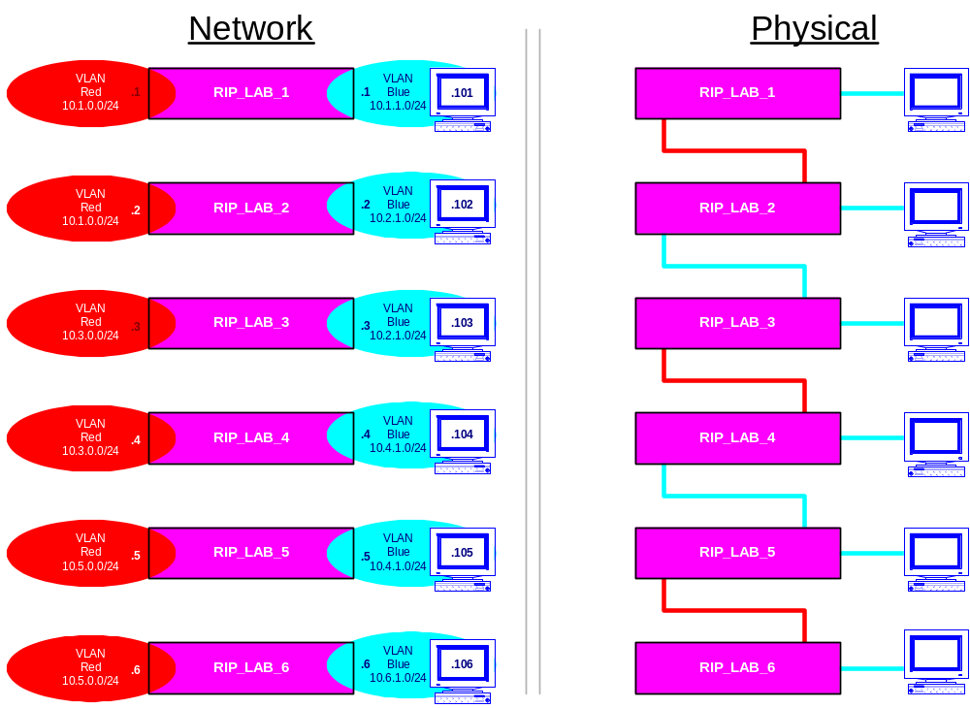
Lab 14 - Network Topology
Notes:
ACTUAL CLI Commands performed in the lab:
create vlan redish
config red ipa <ipaddress>
config red add ports <portlist>
create vlan blue
config blue ipa <ipaddress>
config blue add ports <portlist>
enable ipforwarding
config rip add red
config rip add blue
enable rip
show rip
show ipc
configure laptop and set gateway = nearest router interface
ping interfaces
traceroute

Slide 23
Summary
Provide a brief overview of RIP
Describe the routing table using RIP
Describe the RIP Route Advertisement of VLANs
Discuss RIP Configuration Example
Learn RIP CLI Configuration Commands
Perform a RIP Lab Exercise (Optional)
Notes:
Upon successful completion of this Module, the student participants will be able to achieve the above listed objectives.
This module will discuss IP unicast RIP routing protocols V1 and V2 available on the switch.
We assume that the student is already familiar with IP unicast routing. If not, it is recommended that you refer to the following publications for additional information:
RFC 1058 - Routing Information Protocol (RIP)
RFC 1256 - ICMP Router Discovery Messages
RFC 1723 - RIP Version 2
Book: Interconnections: Bridges and Routers by Radia Perlman
ISBN 0-201-56332-0
Published by Addison-Wesley Publishing Company

Slide 24
This page is left intentionally blank.

